Slide 1
UNIT-4

Slide 3
What is Classification?
Classification is a supervised learning technique used to predict categorical labels.
Data has:
Input features (X)
Known class label (Y)
Example:
Email → Spam / Not Spam
Student → Pass / Fail
Loan → Approved / Rejected

Slide 4
What is Prediction?
Prediction is used to estimate continuous values.
Example:
Predict house price
Predict sales amount
Predict temperature
Classification → Category
Prediction → Numeric value

Slide 5
ISSUES IN CLASSIFICATION & PREDICTION
Overfitting
Model memorizes training data
Poor performance on new data
Underfitting
Model too simple
Low accuracy
Imbalanced Data
One class much larger than other
High Dimensional Data
Too many features
Noise in Data
Incorrect or missing values

Slide 6
Decision Tree
Example: “Should I Play Cricket Today?”
Is it Sunny?
Is it Rainy?
Is it Windy?
Is it Rainy?
Yes → Don't Play
No → Play
A Decision Tree is just a series of questions that leads to a final decision.

Slide 7
A Decision Tree is a supervised learning algorithm used for classification and prediction.
It splits data based on attribute values to make decisions.
Component | Meaning
Root Node | First question
Internal Node | Decision question
Branch | Answer
Leaf Node | Final decision

Slide 8
Why We Need It
How does the system decide which question to ask first?
Why not ask any random question?
This creates curiosity.
Then introduce:
We need a method to choose the “best” question.
Entropy and Information Gain.

Slide 9
What is Entropy?
Entropy is a measure of impurity or uncertainty in a dataset.
In classification:
If all records belong to one class → Entropy = 0 (pure node)
If records are equally mixed → Entropy = 1 (maximum impurity for 2 classes)

Slide 10

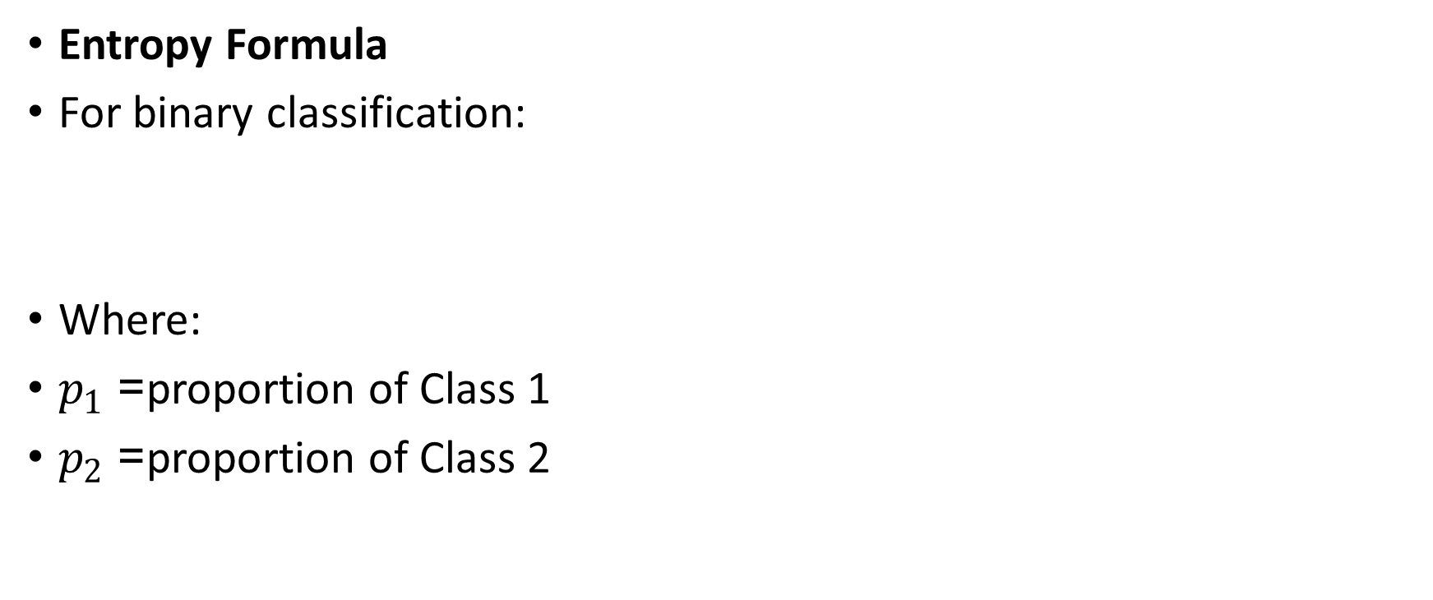
Entropy Formula
For binary classification:
Where:
$p_{1}$= proportion of Class 1
$p_{2}$= proportion of Class 2

Slide 11
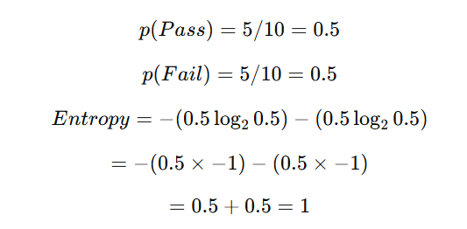
Simple Example
Suppose we have 10 students:
5 Pass
5 Fail
Entropy = 1 (Maximum impurity)
Because it is completely mixed.

Slide 12

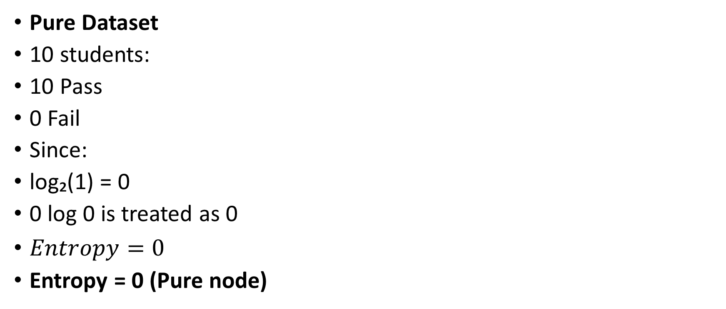
Pure Dataset
10 students:
10 Pass
0 Fail
Since:
log₂(1) = 0
0 log 0 is treated as 0
$Entropy=0$
Entropy = 0 (Pure node)

Slide 13
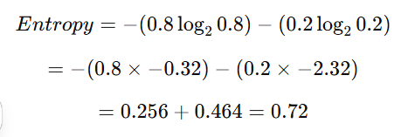
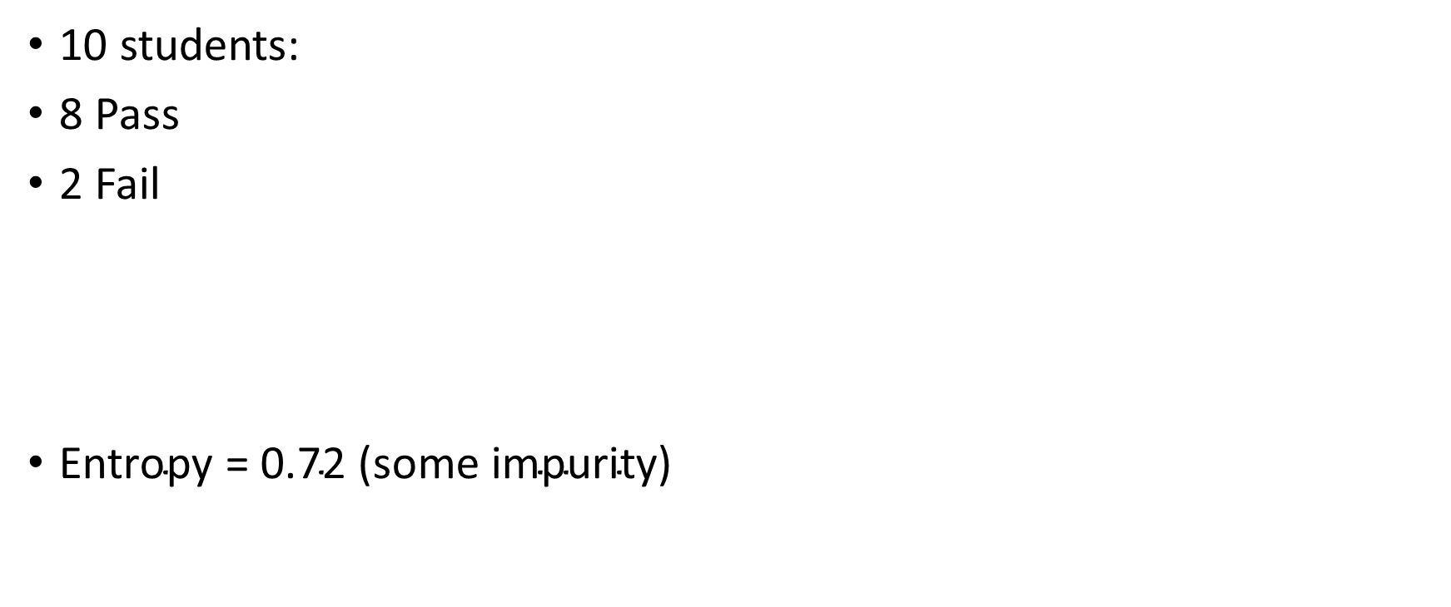
10 students:
8 Pass
2 Fail
$\text{Entropy}\text{ = }\text{0.72 }\text{(}\text{some} \text{impurity}\text{)}$

Slide 14
Distribution | Entropy
100% same class | 0
80%-20% | 0.72
50%-50% | 1

Slide 15

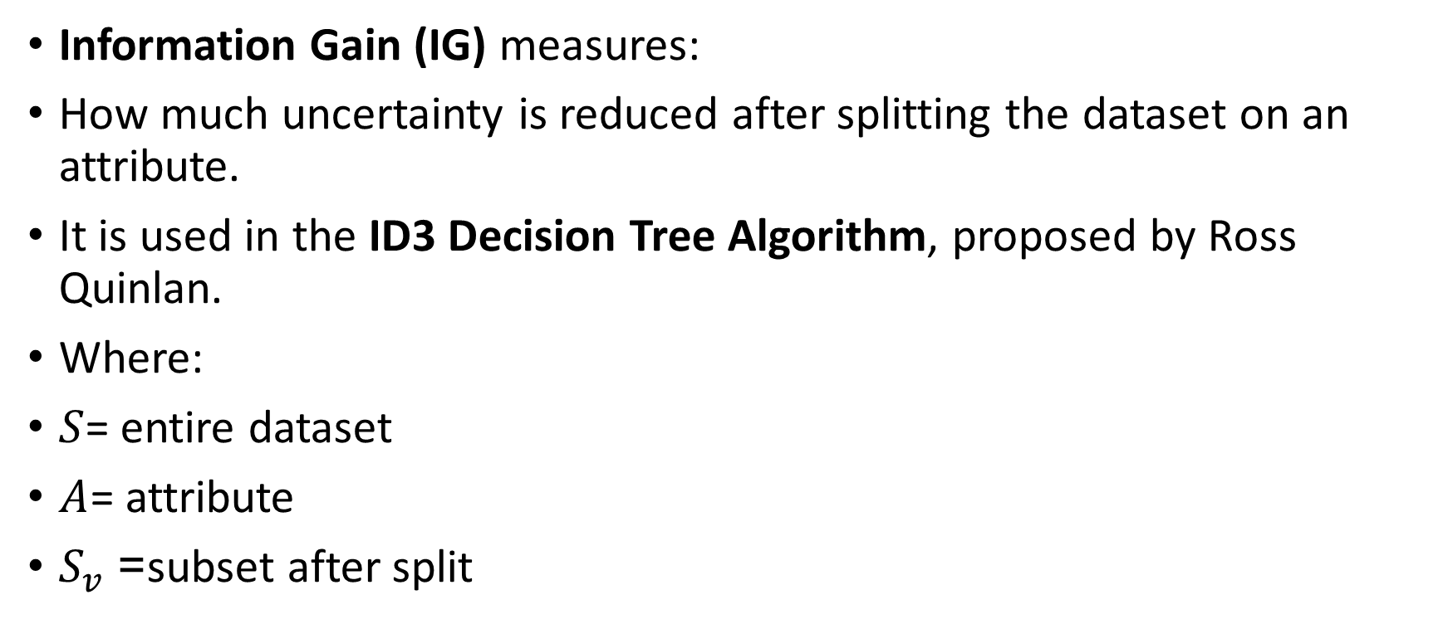
Information Gain
Information Gain (IG) measures:
How much uncertainty is reduced after splitting the dataset on an attribute.
It is used in the ID3 Decision Tree Algorithm, proposed by Ross Quinlan.
Where:
$S$= entire dataset
$A$= attribute
$S_{v}$= subset after split

Slide 16
Simple Scenario
Dataset: 6 loan applicants
4 Approve
2 Reject
This is a binary classification problem.

Slide 17
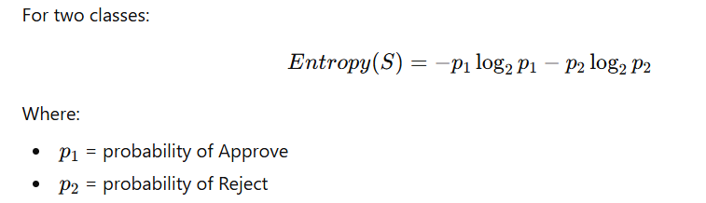
Write the Entropy Formula

Slide 18

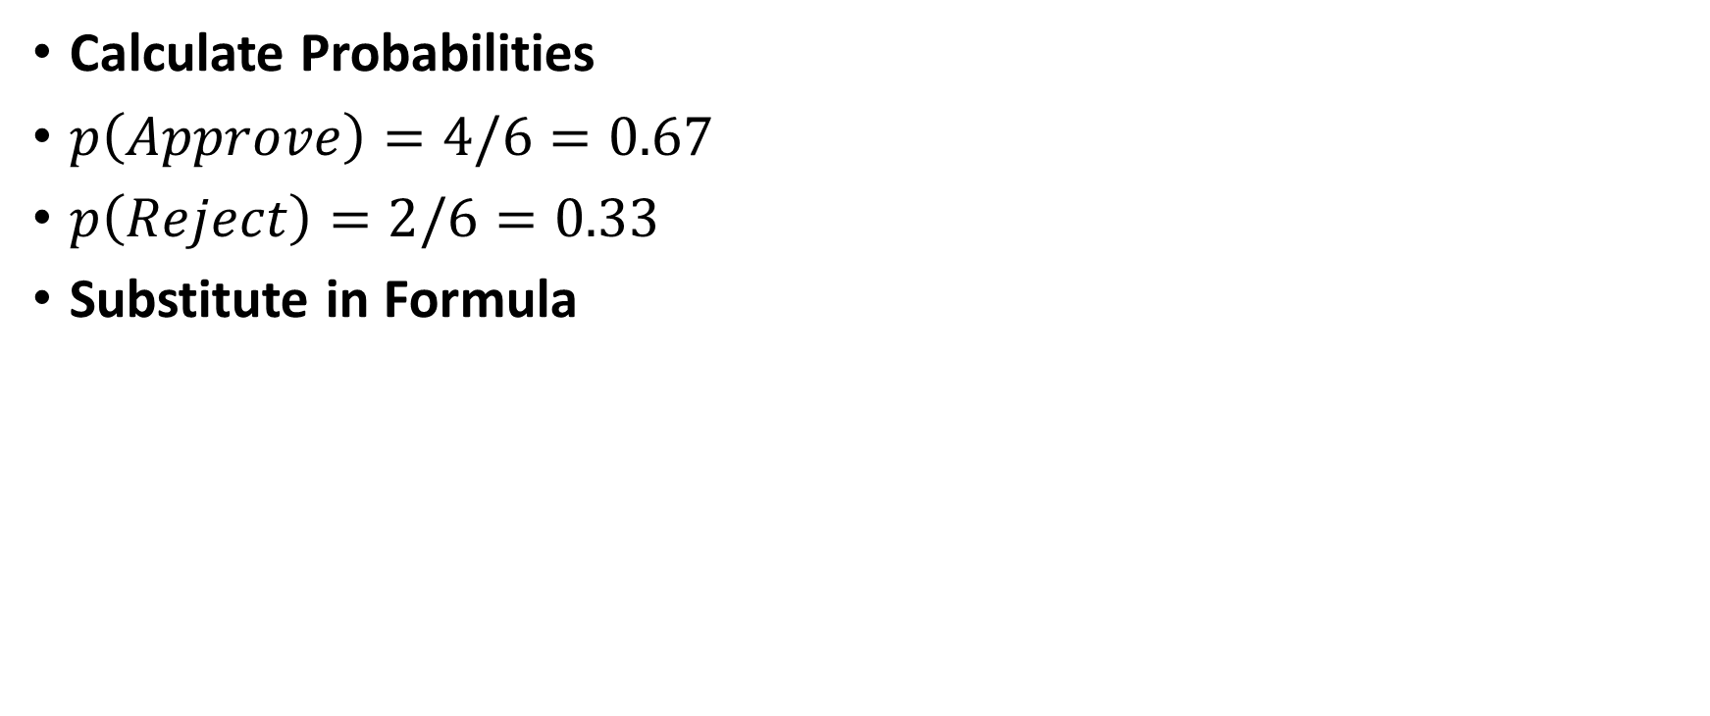
Calculate Probabilities
$p\left(Approve\right)=4/6=0.67$
$p\left(Reject\right)=2/6=0.33$
Substitute in Formula

Slide 19
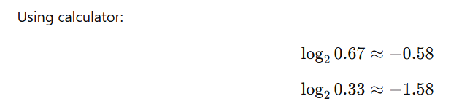
Find Log Values (log of numbers less than 1 is negative.)

Slide 20
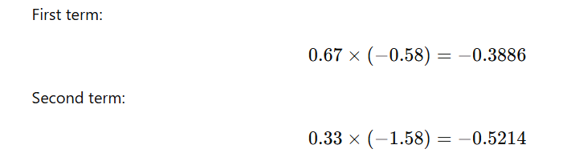
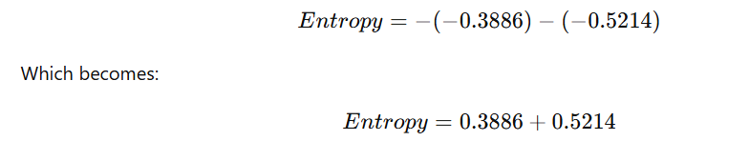

Slide 21
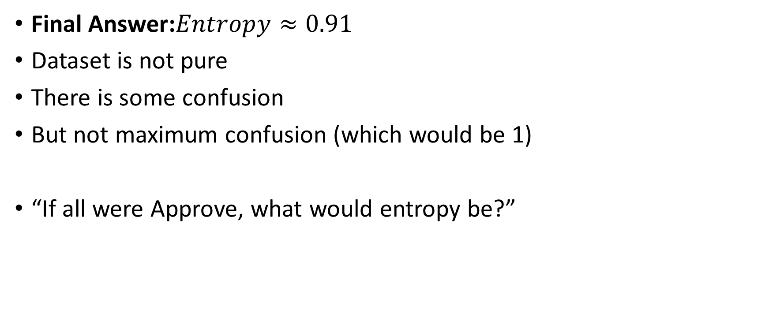
Final Answer:$Entropy≈0.91$
Dataset is not pure
There is some confusion
But not maximum confusion (which would be 1)
“If all were Approve, what would entropy be?”

Slide 22
CLASSIFICATION ALGORITHMS
DECISION TREE
A tree-like structure used for decision making.
Root → Top node
Internal node → Condition
Leaf node → Final class

Slide 23
Example of Decision Tree
Example: Loan Approval
If Income > 50,000
If Credit Score > 700 → Approved
Else → Not Approved
Else → Not Approved

Slide 24
Advantages of Decision Tree
Easy to understand
Easy to draw
Handles numerical & categorical data
Disadvantages:
Can overfit
Sensitive to small changes

Slide 25
Example Decision Tree
Problem Scenario
A bank wants to decide whether to approve a loan or not based on two attributes:
Income (High / Low)
Credit Score (Good / Bad)
Target variable (Class Label):
Loan Status → Approve / Reject
Construct a Decision Tree using the ID3 algorithm (Information Gain method).

Slide 26
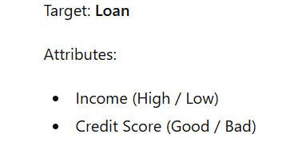
Training Dataset
Applicant | Income | Credit Score | Loan
A1 | High | Good | Approve
A2 | High | Bad | Approve
A3 | Low | Good | Approve
A4 | Low | Bad | Reject
A5 | High | Good | Approve
A6 | Low | Bad | Reject
Total records = 6
Approve = 4
Reject = 2

Slide 27
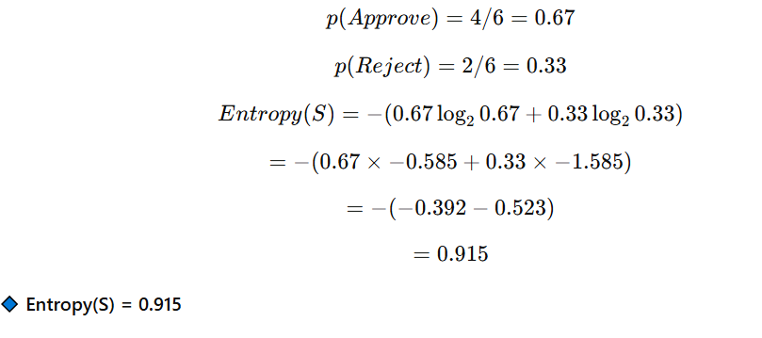
Step 1:Calculate Entropy of Entire Dataset

Slide 28
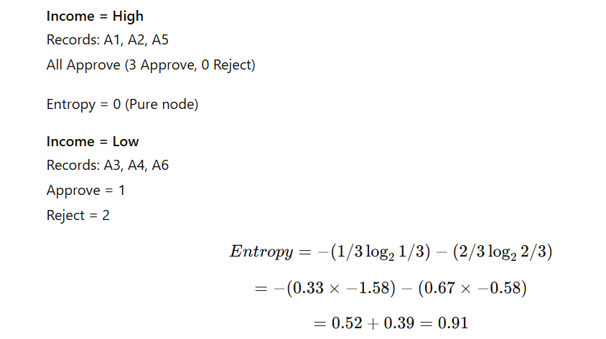
STEP 2: Calculate Information Gain for Each Attribute

Slide 29
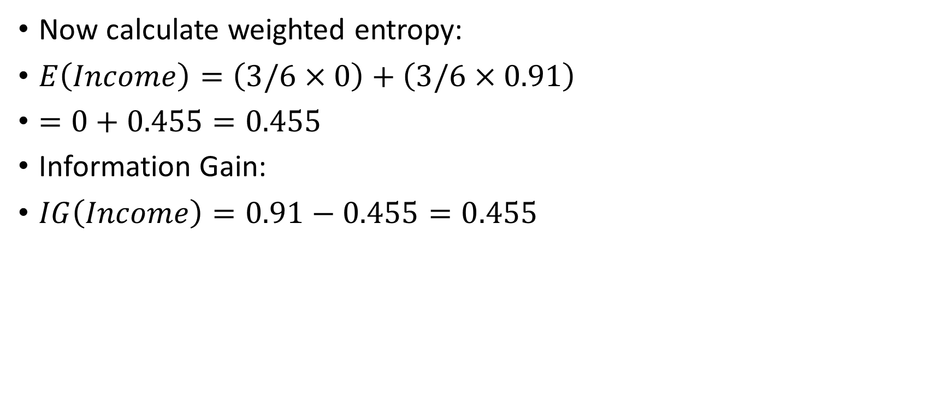
Now calculate weighted entropy:
$E\left(Income\right)=\left(3/6×0\right)+\left(3/6×0.91\right)$
$=0+0.455=0.455$
Information Gain:
$IG\left(Income\right)=0.91−0.455=0.455$

Slide 30
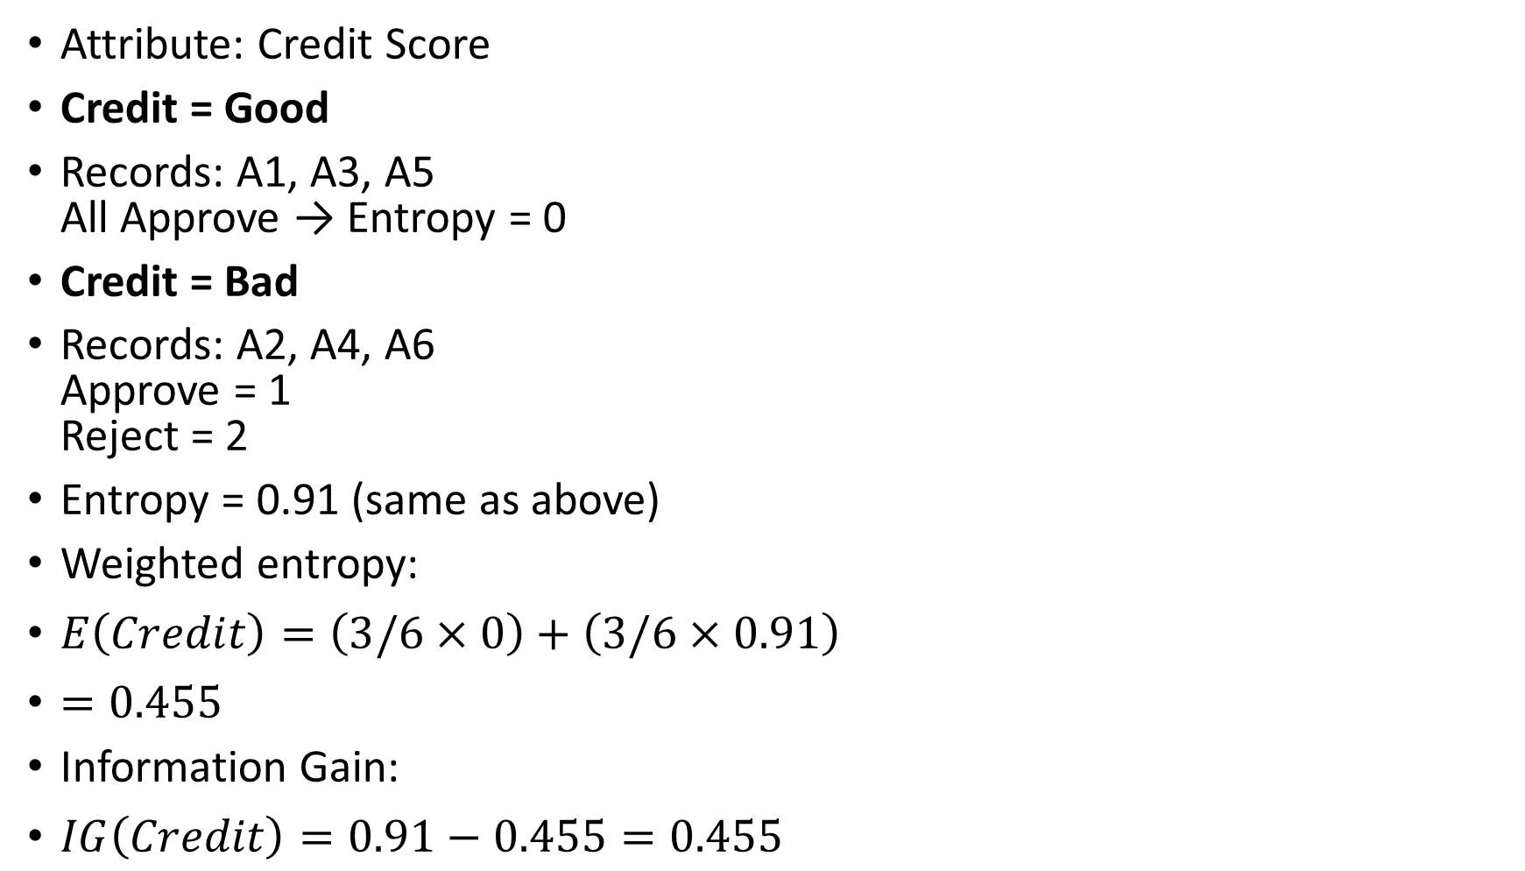
Attribute: Credit Score
Credit = Good
Records: A1, A3, A5
All Approve → Entropy = 0
Credit = Bad
Records: A2, A4, A6
Approve = 1
Reject = 2
Entropy = 0.91 (same as above)
Weighted entropy:
$E\left(Credit\right)=\left(3/6×0\right)+\left(3/6×0.91\right)$
$=0.455$
Information Gain:
$IG\left(Credit\right)=0.91−0.455=0.455$

Slide 31
Step 3:Choose Root Node
Both attributes give same Information Gain (0.455).
In such cases:
Choose any (or based on domain importance)
Let us choose Income as root.

Slide 32
STEP 4: Build Tree
Root: Income
Income = High
All Approve → Pure Node
Loan = Approve
Income = Low
Records:
A3 (Good → Approve)
A4 (Bad → Reject)
A6 (Bad → Reject)
Not pure → Split again using remaining attribute (Credit Score)

Slide 33
STEP 5: Split Income = Low on Credit Score
Credit = Good
A3 → Approve
Entropy = 0
Credit = Bad
A4, A6 → Reject
Entropy = 0

Slide 34
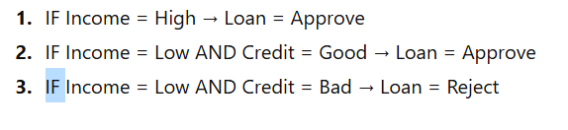
Final Decision Tree
Income
/ \
High Low
| |
Approve Credit
/ \
Good Bad
| |
Approve Reject

Slide 35
Based On Credit
Credit
/ \
Good Bad
| Income
Approve / \
High Low
| |
Approve Reject

Slide 36
Problem-2
Problem: Play Tennis Decision
A student wants to decide whether to Play Tennis or Not Play based on:
Outlook (Sunny / Rainy)
Wind (Weak / Strong)
Target:
Play (Yes / No)

Slide 37
ID | Outlook | Wind | Play
1 | Sunny | Weak | Yes
2 | Sunny | Strong | No
3 | Rainy | Weak | Yes
4 | Rainy | Strong | No
5 | Sunny | Weak | Yes
6 | Rainy | Weak | Yes

Slide 38
Target: Play
Attributes:
Outlook (Sunny / Rainy)
Wind (Weak / Strong)
Total = 6
Yes = 4
No = 2

Slide 39
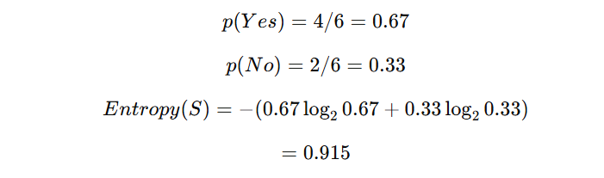
STEP 1: Entropy of Entire Dataset

Slide 40
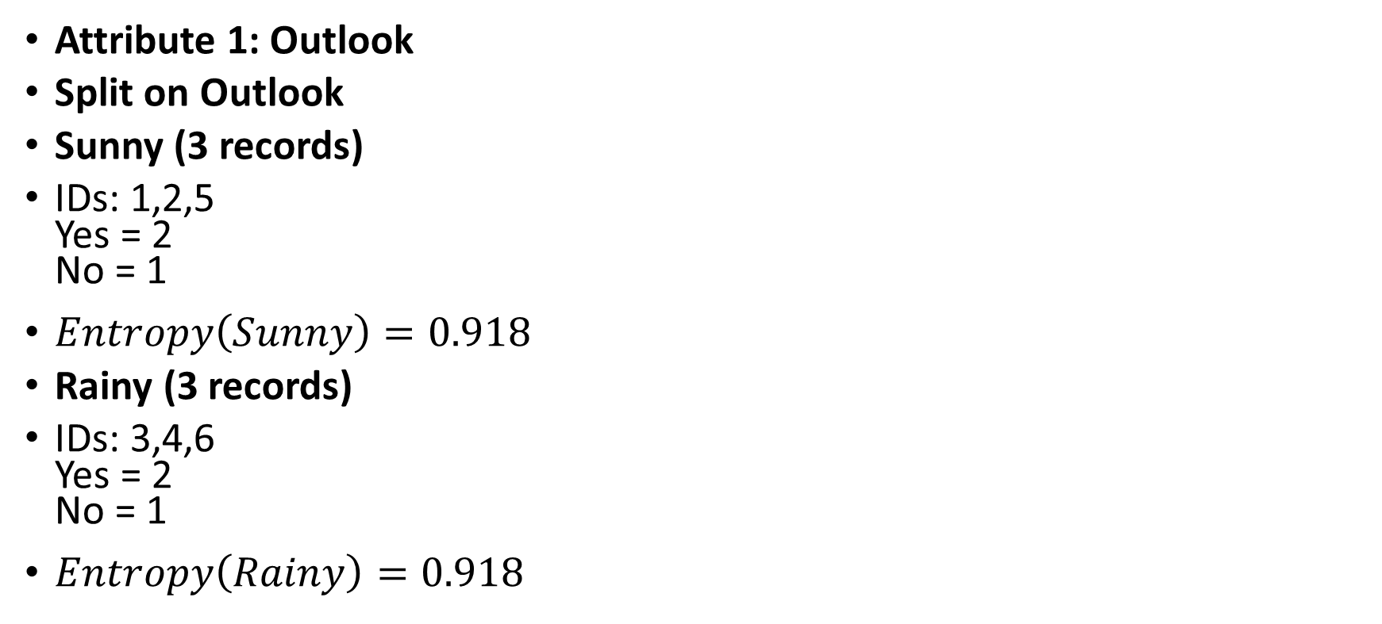
STEP 2: Calculate Information Gain
Attribute 1: Outlook
Split on Outlook
Sunny (3 records)
IDs: 1,2,5
Yes = 2
No = 1
$Entropy\left(Sunny\right)=0.918$
Rainy (3 records)
IDs: 3,4,6
Yes = 2
No = 1
$Entropy\left(Rainy\right)=0.918$

Slide 41
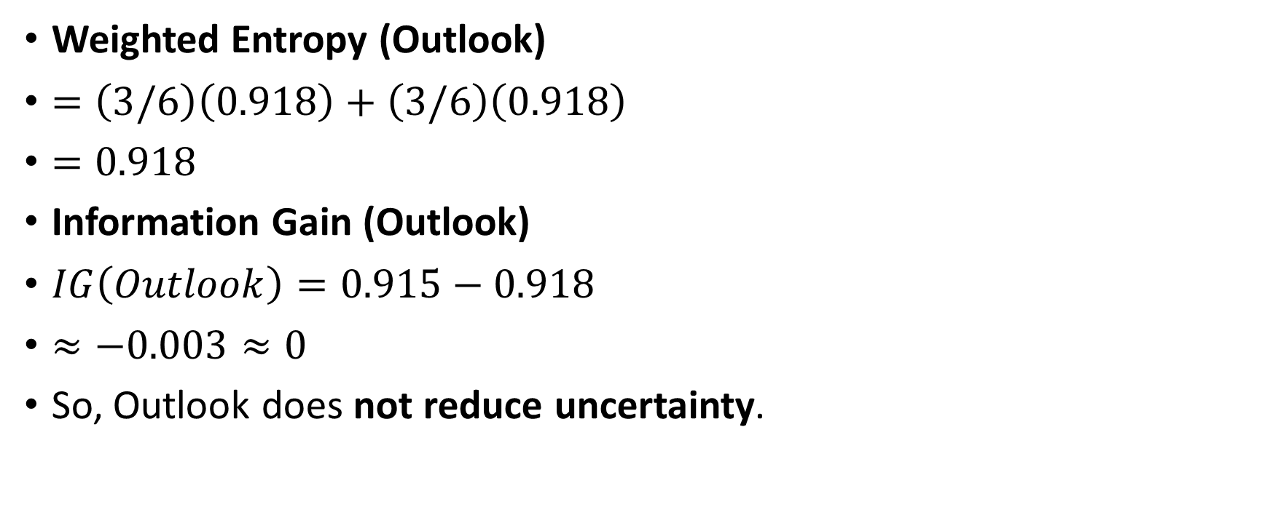
Weighted Entropy (Outlook)
$=\left(3/6\right)\left(0.918\right)+\left(3/6\right)\left(0.918\right)$
$=0.918$
Information Gain (Outlook)
$IG\left(Outlook\right)=0.915−0.918$
$≈−0.003≈0$
So, Outlook does not reduce uncertainty.

Slide 42
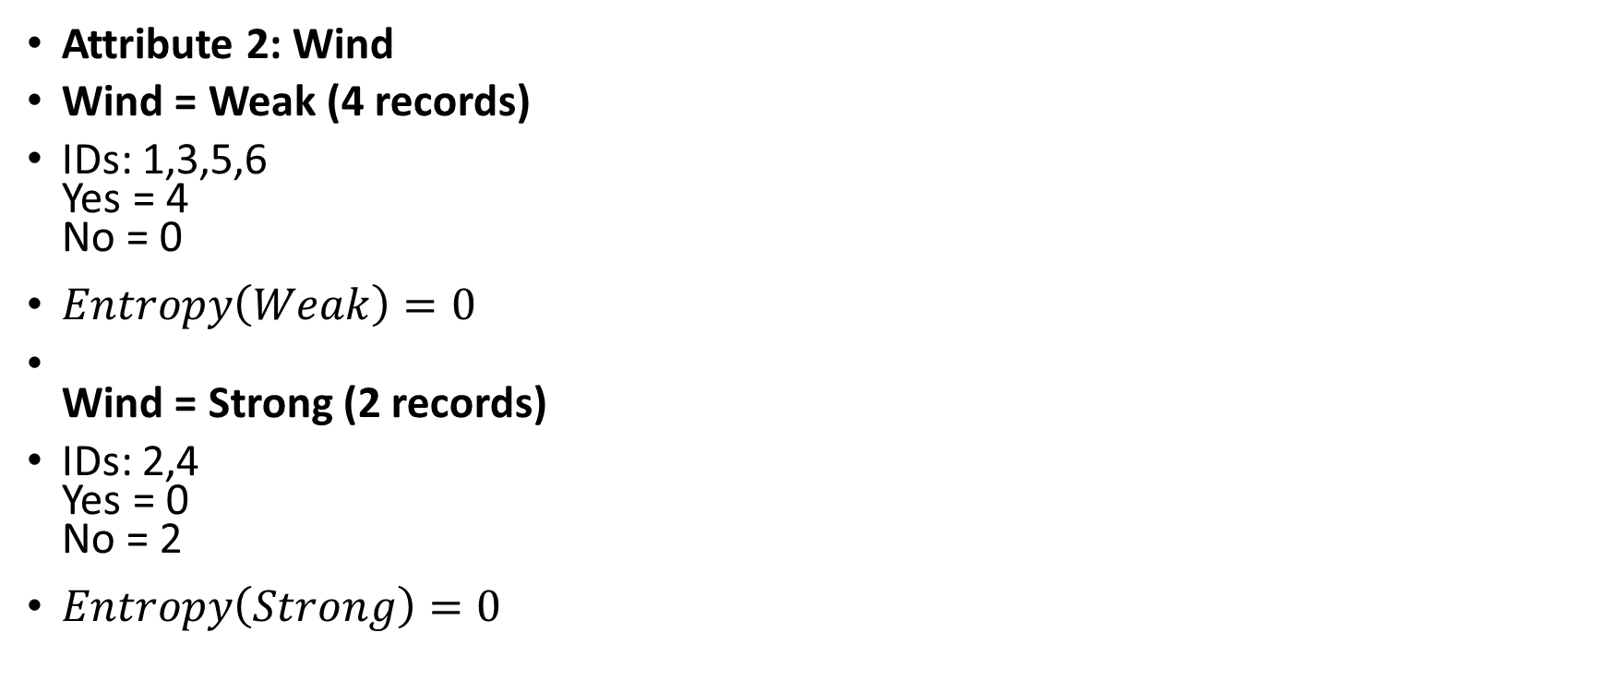
Attribute 2: Wind
Wind = Weak (4 records)
IDs: 1,3,5,6
Yes = 4
No = 0
$Entropy\left(Weak\right)=0$
Wind = Strong (2 records)
IDs: 2,4
Yes = 0
No = 2
$Entropy\left(Strong\right)=0$

Slide 43
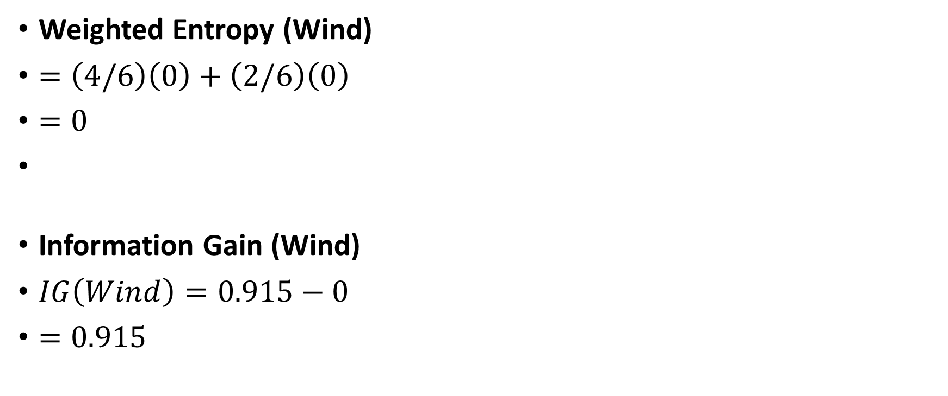
Weighted Entropy (Wind)
$=\left(4/6\right)\left(0\right)+\left(2/6\right)\left(0\right)$
$=0$
Information Gain (Wind)
$IG\left(Wind\right)=0.915−0$
$=0.915$

Slide 44
STEP 3: Choose Root Node
Highest Information Gain = Wind (0.915)
So root node is:
Wind

Slide 45
STEP 4: Construct Tree
If Wind = Weak
All Yes → Pure node
Play = Yes
If Wind = Strong
All No → Pure node
Play = No

Slide 46
Wind
/ \
Weak Strong
| |
Yes No
IF Wind = Weak → Play = Yes
IF Wind = Strong → Play = No

Slide 47
Problem-3(Assignment)
Problem: Loan Approval Decision
A bank decides whether to Approve or Reject a loan based on:
Income (High / Low)
Credit Score (Good / Bad)
Employment (Stable / Unstable)
Target:
Loan (Approve / Reject)

Slide 48
ID | Income | Credit | Employment | Loan
1 | High | Good | Stable | Approve
2 | High | Good | Unstable | Approve
3 | High | Bad | Stable | Approve
4 | Low | Good | Stable | Approve
5 | Low | Bad | Stable | Reject
6 | Low | Bad | Unstable | Reject
7 | High | Bad | Unstable | Reject
8 | Low | Good | Unstable | Reject

Slide 49
BAYESIAN CLASSIFICATION
1. Introduction to Classification
Classification is a supervised learning technique used to assign a class label to data.
Email | Class
Win a lottery now | Spam
Meeting at 10 AM | Not Spam
The goal of classification is to predict the class of new data based on training data.
Common classification algorithms:
Decision Tree
k-Nearest Neighbor
Support Vector Machine
Bayesian Classification

Slide 50
What is Bayesian Classification?
Bayesian classification is a statistical classifier based on probability theory.
It predicts the probability that a data item belongs to a particular class.
Example:
Medical diagnosis:
Symptoms | Disease
Fever + cough | Flu

Slide 51
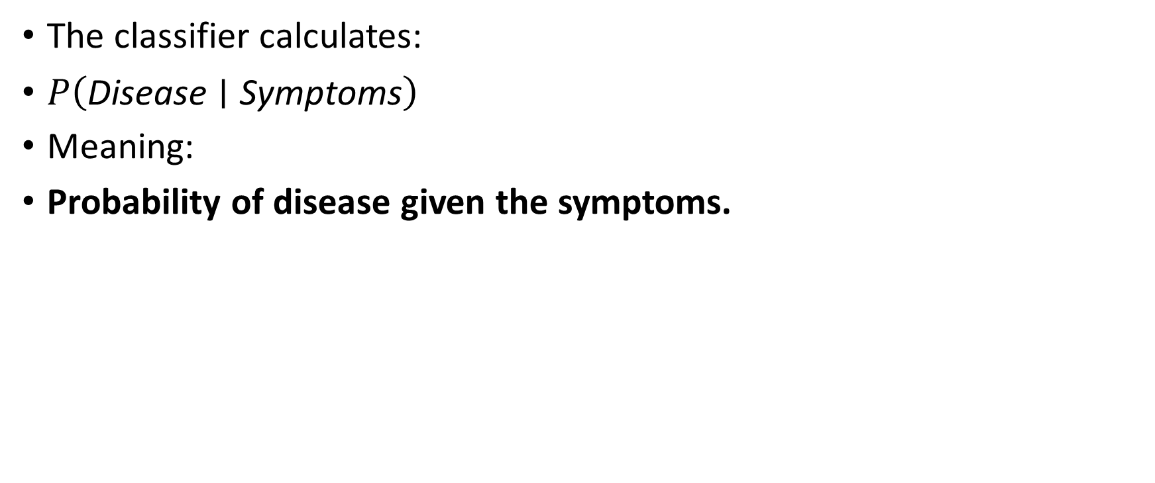
The classifier calculates:
$P\left(\text{Disease}∣\text{Symptoms}\right)$
Meaning:
Probability of disease given the symptoms.

Slide 52
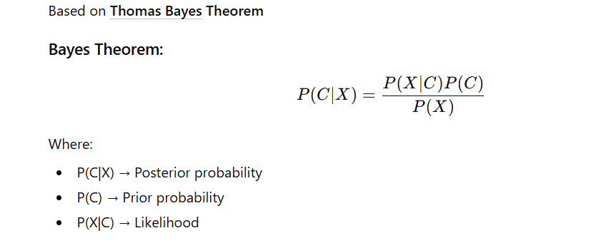
Bayes Theorem

Slide 53
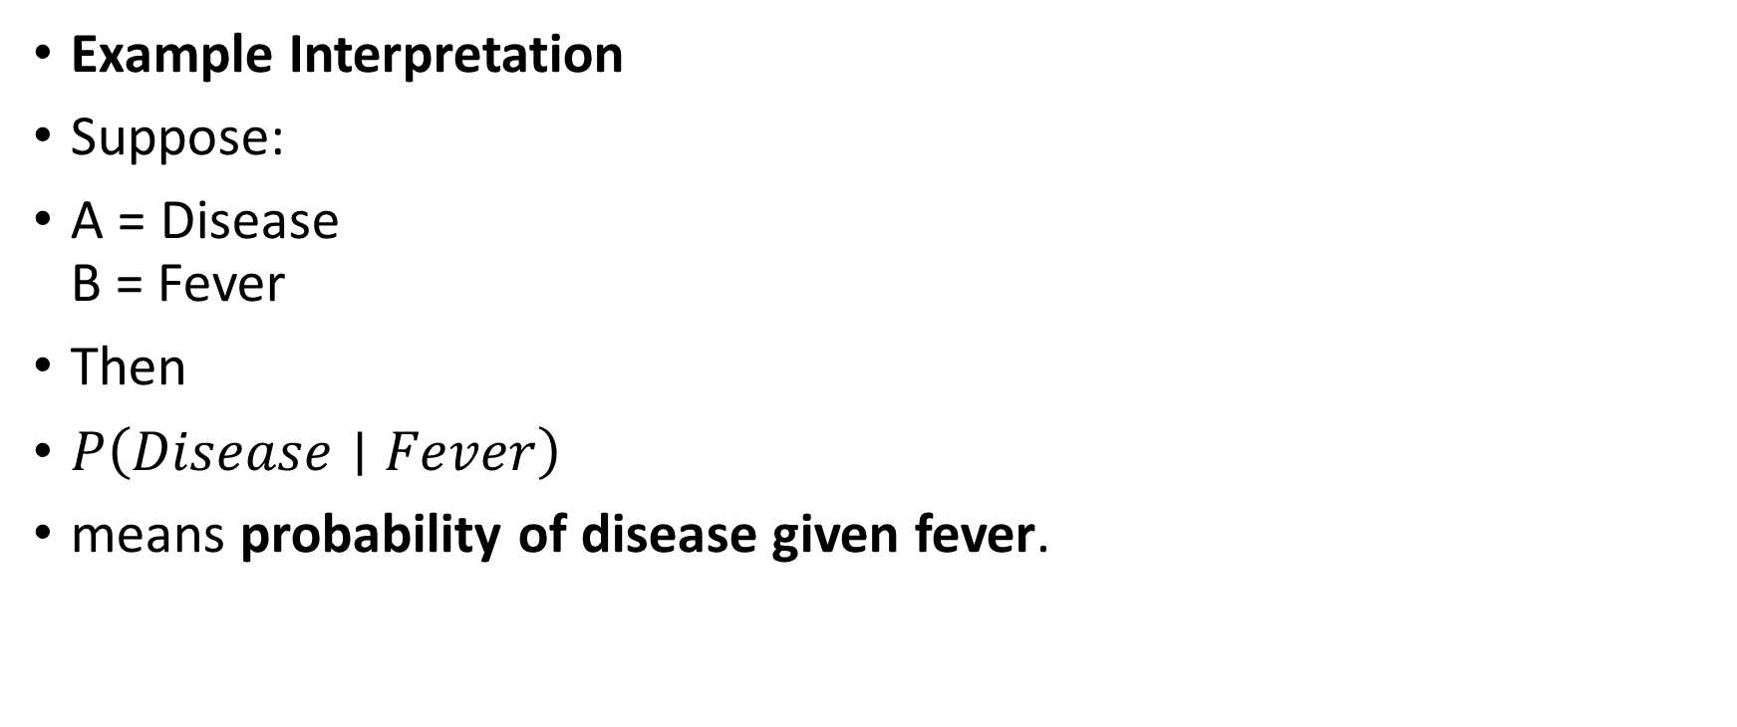
Example Interpretation
Suppose:
A = Disease
B = Fever
Then
$P\left(Disease∣Fever\right)$
means probability of disease given fever.

Slide 54
Components of Bayesian Classification
1. Prior Probability
Probability of a class before seeing data.
Example:
Class | Probability
Spam | 0.4
Not Spam | 0.6

Slide 55
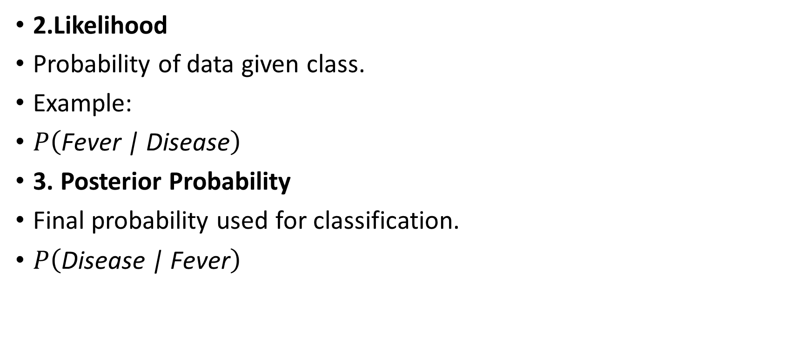
2.Likelihood
Probability of data given class.
Example:
$P\left(\text{Fever}\text{ | }\text{Disease}\right)$
3. Posterior Probability
Final probability used for classification.
$P\left(\text{Disease}\text{ | }\text{Fever}\right)$

Slide 56
5. Naïve Bayes Classifier
Naïve Bayes assumes that all features are independent.
Example:
For medical diagnosis
Symptoms:
Fever
Cough
Headache

Slide 57
Steps of Naïve Bayes Algorithm
Calculate prior probability for each class
Calculate likelihood for each feature
Apply Bayes formula
Select class with maximum probability

Slide 58
Example1 We need to classify based on Weather using Naïve Bayes.
Weather | Play Tennis
Sunny | No
Sunny | No
Overcast | Yes
Rain | Yes
Rain | Yes

Slide 59
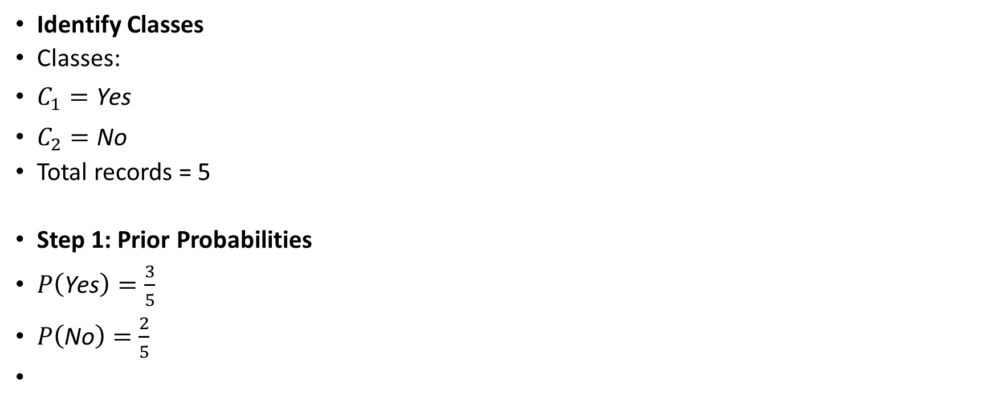
Identify Classes
Classes:
$C_{1}=\text{Yes}$
$C_{2}=\text{No}$
Total records = 5
Step 1: Prior Probabilities
$P\left(\text{Yes}\right)=\frac{3}{5}$
$P\left(\text{No}\right)=\frac{2}{5}$

Slide 60
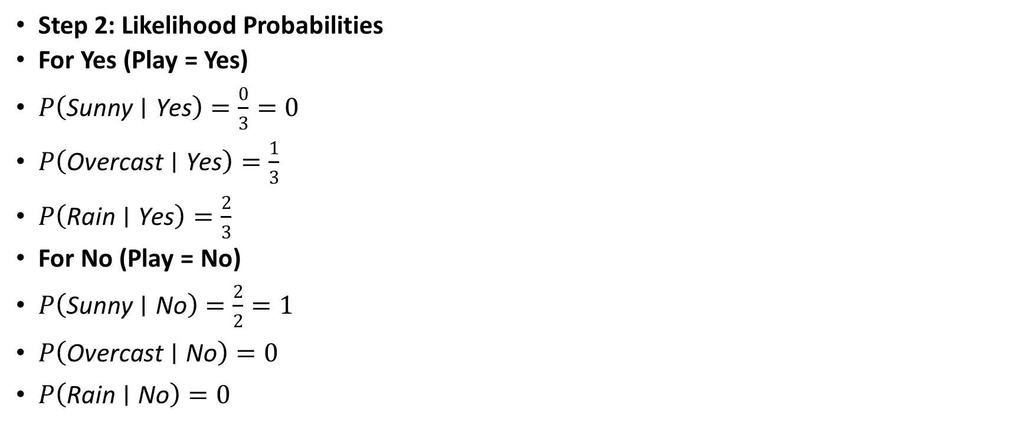
Step 2: Likelihood Probabilities
For Yes (Play = Yes)
$P\left(\text{Sunny}∣\text{Yes}\right)=\frac{0}{3}=0$
$P\left(\text{Overcast}∣\text{Yes}\right)=\frac{1}{3}$
$P\left(\text{Rain}∣\text{Yes}\right)=\frac{2}{3}$
For No (Play = No)
$P\left(\text{Sunny}∣\text{No}\right)=\frac{2}{2}=1$
$P\left(\text{Overcast}∣\text{No}\right)=0$
$P\left(\text{Rain}∣\text{No}\right)=0$

Slide 61
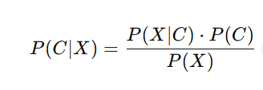
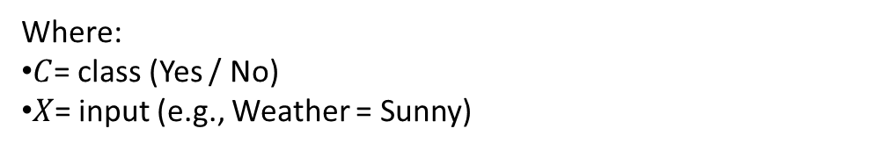
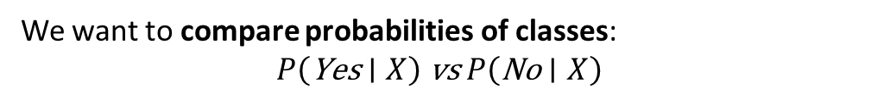
Step 3: Apply Naïve Bayes Formula
Where:
$C$= class (Yes / No)
$X$= input (e.g., Weather = Sunny)
We want to compare probabilities of classes:
$$P\left(\text{Yes}∣X\right) \text{vs} P\left(\text{No}∣X\right)$$

Slide 62
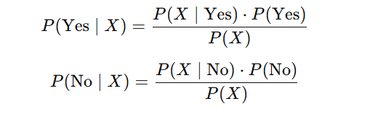
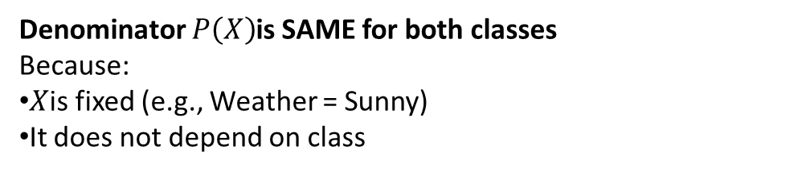
Denominator $P\left(X\right)$is SAME for both classes
Because:
$X$is fixed (e.g., Weather = Sunny)
It does not depend on class

Slide 63
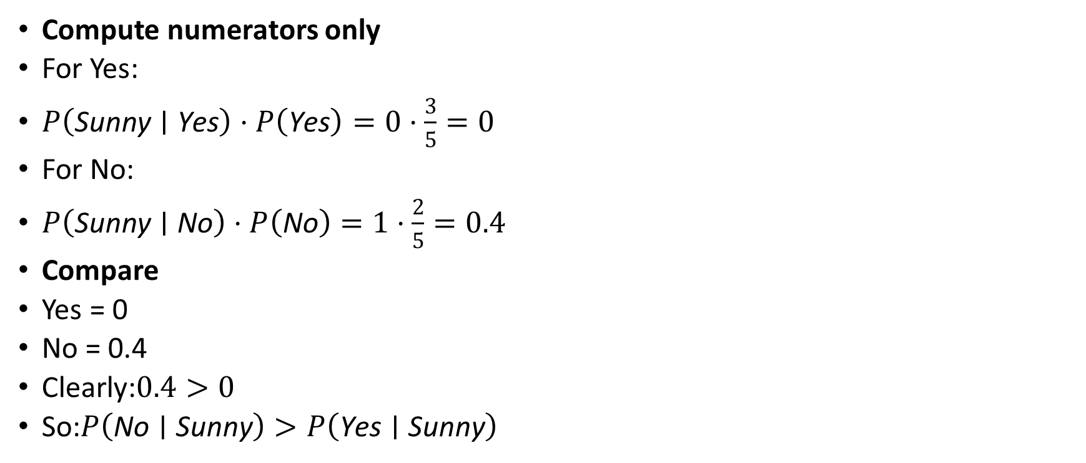
Compute numerators only
For Yes:
$P\left(\text{Sunny}∣\text{Yes}\right)⋅P\left(\text{Yes}\right)=0⋅\frac{3}{5}=0$
For No:
$P\left(\text{Sunny}∣\text{No}\right)⋅P\left(\text{No}\right)=1⋅\frac{2}{5}=0.4$
Compare
Yes = 0
No = 0.4
Clearly:$0.4>0$
So:$P\left(\text{No}∣\text{Sunny}\right)>P\left(\text{Yes}∣\text{Sunny}\right)$

Slide 64
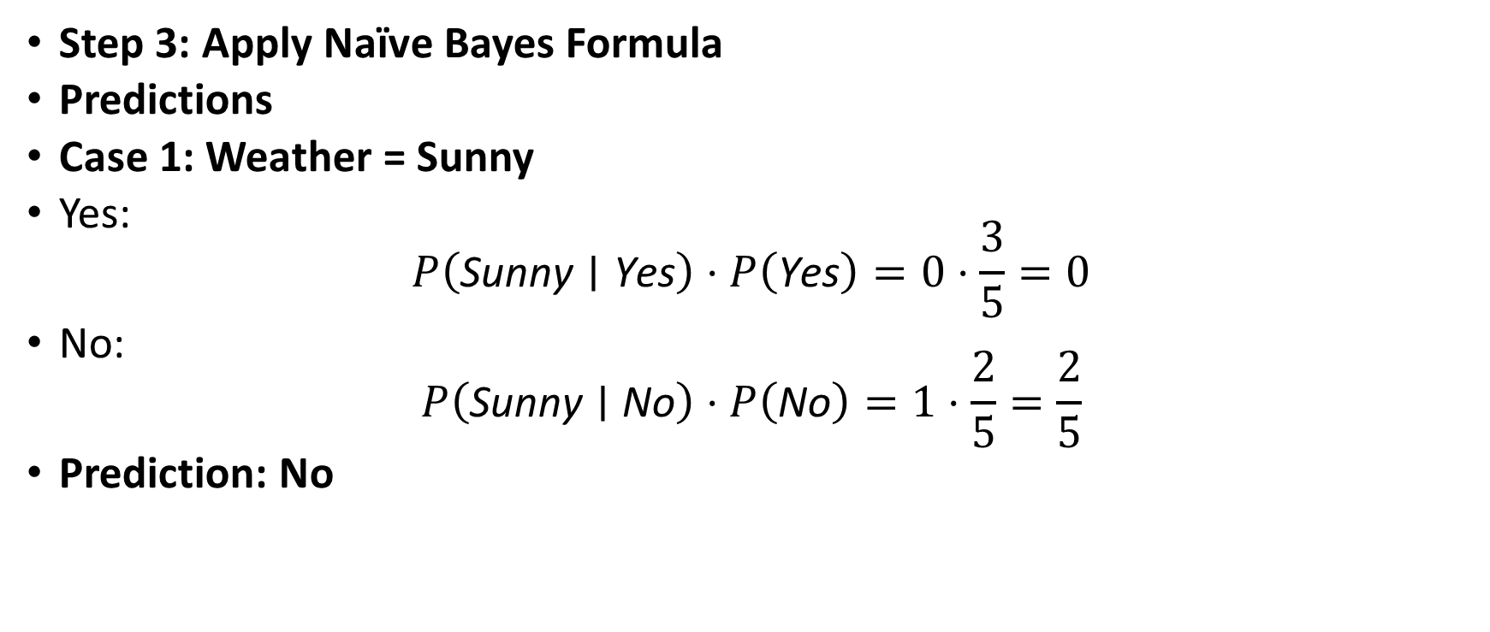
Step 3: Apply Naïve Bayes Formula
Predictions
Case 1: Weather = Sunny
Yes:
$P\left(\text{Sunny}∣\text{Yes}\right)⋅P\left(\text{Yes}\right)=0⋅\frac{3}{5}=0$
No:
$P\left(\text{Sunny}∣\text{No}\right)⋅P\left(\text{No}\right)=1⋅\frac{2}{5}=\frac{2}{5}$
Prediction: No

Slide 65
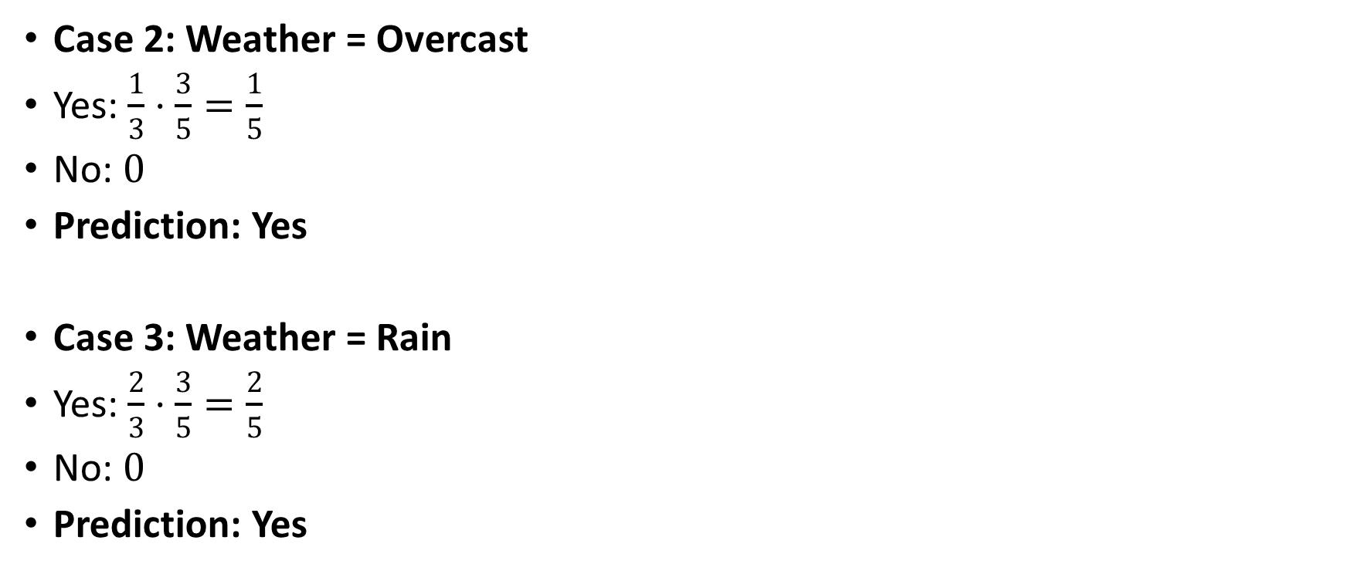
Case 2: Weather = Overcast
Yes: $\frac{1}{3}⋅\frac{3}{5}=\frac{1}{5}$
No: $0$
Prediction: Yes
Case 3: Weather = Rain
Yes: $\frac{2}{3}⋅\frac{3}{5}=\frac{2}{5}$
No: $0$
Prediction: Yes

Slide 66
Weather | Predicted Play Tennis
Sunny | No
Overcast | Yes
Rain | Yes

Slide 67
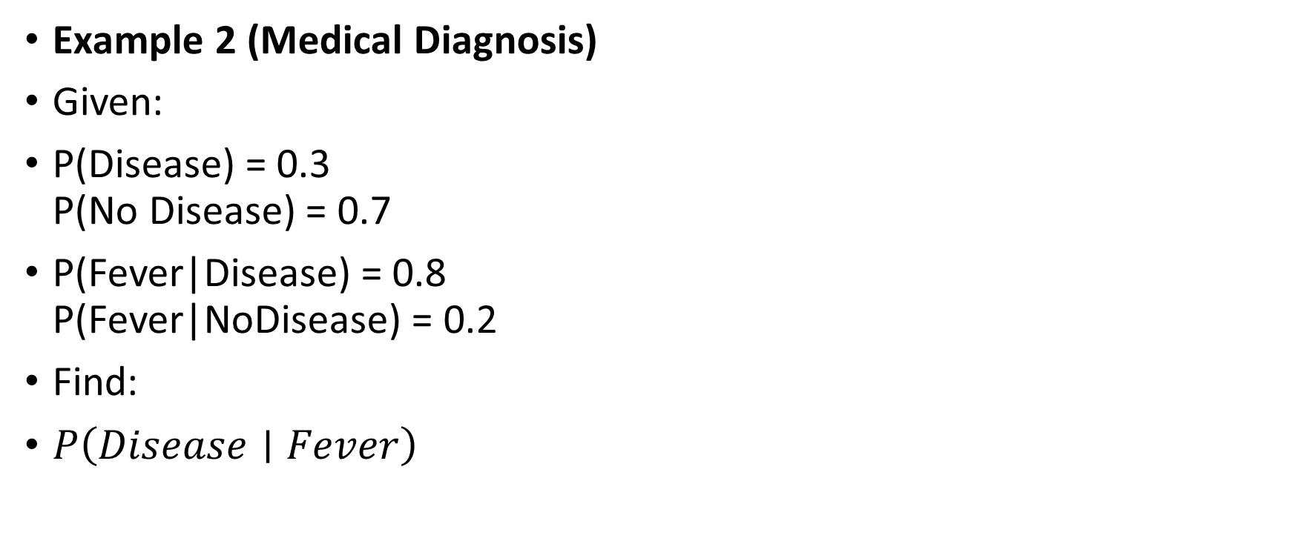
Example 2 (Medical Diagnosis)
Given:
P(Disease) = 0.3
P(No Disease) = 0.7
P(Fever|Disease) = 0.8
P(Fever|NoDisease) = 0.2
Find:
$P\left(Disease∣Fever\right)$

Slide 68
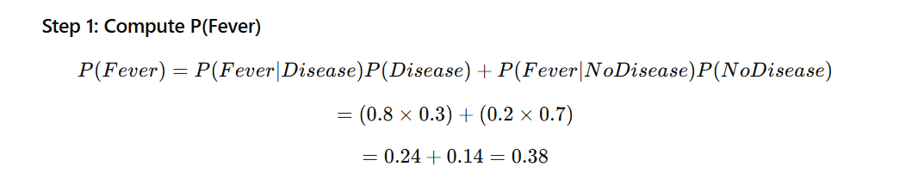

Slide 69
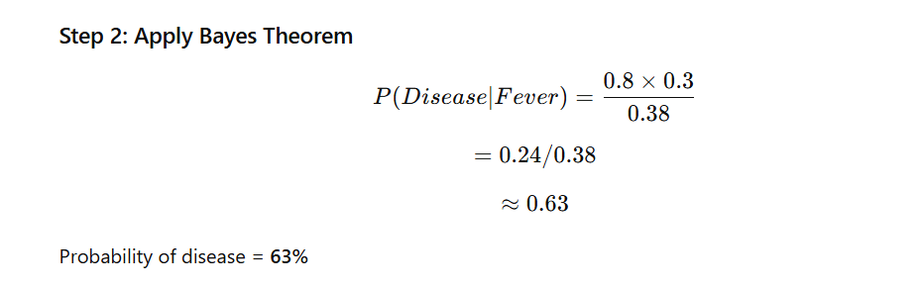

Slide 70
Types of Naïve Bayes Classifiers
1. Gaussian Naïve Bayes
Used for continuous data.
Example:
Height
Weight
2. Multinomial Naïve Bayes
Used for text classification.
Example:
Spam detection
3. Bernoulli Naïve Bayes
Used for binary features.
Example:
Word present or not present.

Slide 71
Advantages of Bayesian Classification
Very fast algorithm
Works well with large datasets
Performs well in text classification
Requires small training data
Disadvantages
Assumes feature independence
Zero probability problem
Sensitive to data quality

Slide 72
Applications of Bayesian Classification
Email spam detection
Medical diagnosis
Document classification
Sentiment analysis
Recommendation systems

Slide 73
Prior Probability
↓
Likelihood
↓
Bayes Rule
↓
Posterior Probability
↓
Class Prediction

Slide 74
Problem 1
A disease affects 5% of the population.
Probability that a test detects disease correctly: P(Positive | Disease) = 0.9
Probability that the test is positive for a healthy person: P(Positive | No Disease) = 0.1
Find:
Probability that a randomly selected person tests positive.
Probability that the person actually has the disease given that the test is positive

Slide 75
Step 1: Given Data
P(Disease) = 0.05
P(No Disease) = 0.95
P(Positive | Disease) = 0.9
P(Positive | No Disease) = 0.1

Slide 76
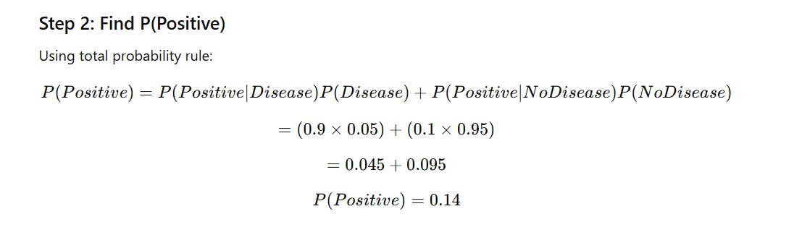

Slide 77
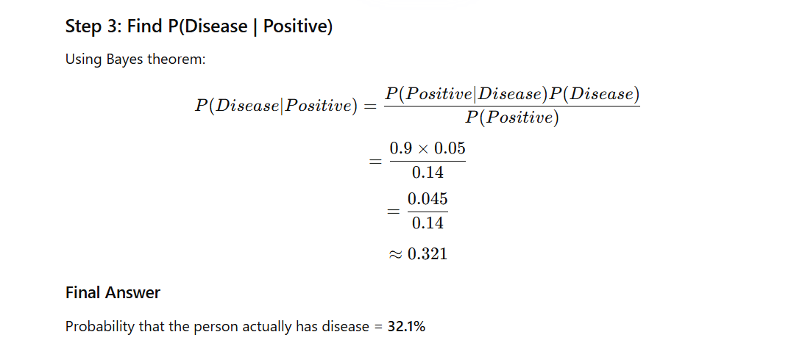

Slide 78
Problem 2:
Dataset:
Study | Sleep | Pass
Yes | Good | Yes
Yes | Poor | Yes
No | Good | No
Yes | Good | Yes
No | Poor | No
Predict class for:
Study = Yes, Sleep = Good

Slide 79
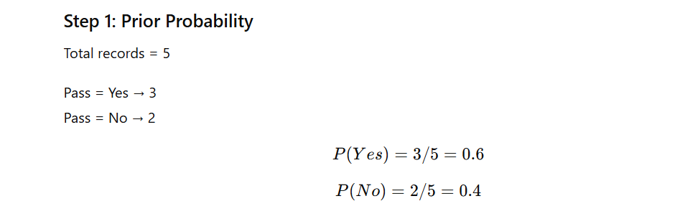

Slide 80
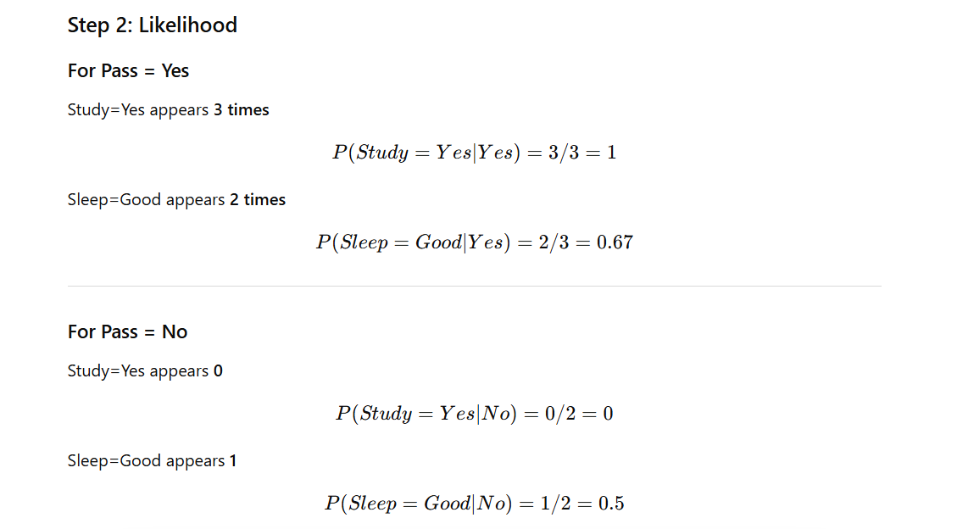

Slide 81
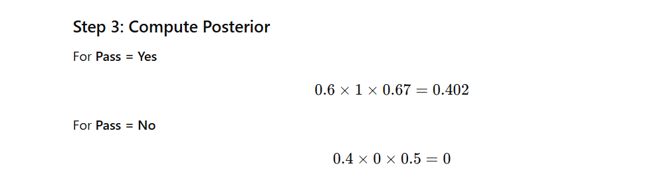

Slide 82
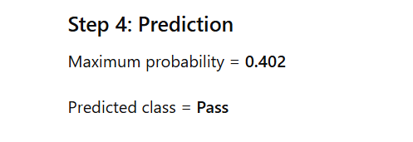

Slide 83
Problem : Weather Classification
Weather | Humidity | Play
Sunny | High | No
Sunny | High | No
Overcast | High | Yes
Rain | High | Yes
Rain | Normal | Yes
Sunny | Normal | Yes
Predict:
Weather = Sunny, Humidity = High

Slide 84
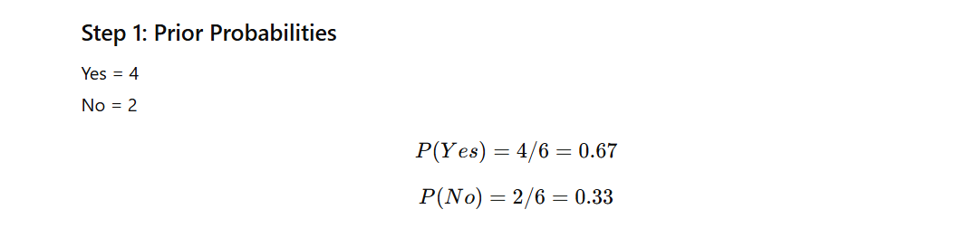

Slide 85
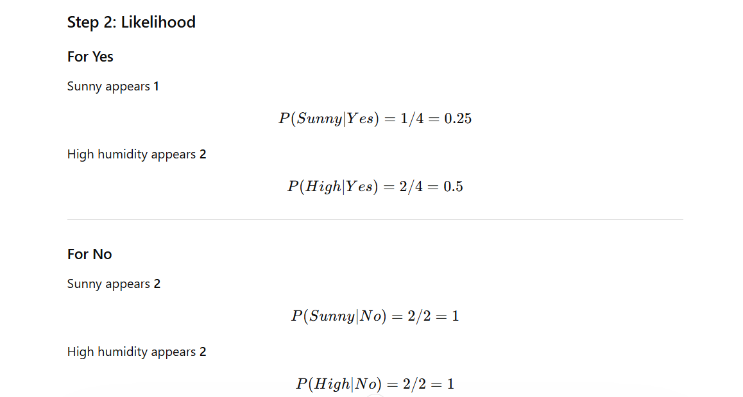

Slide 86
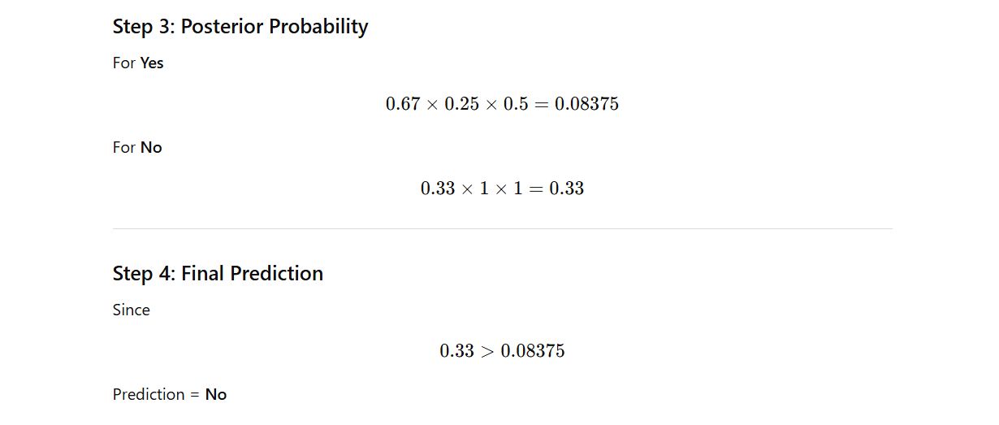

Slide 87
K-NEAREST NEIGHBOUR (KNN)
Unlike other algorithms, KNN doesn't "learn" a model during training; it simply stores the data and waits until you give it a new point to classify.
Similar things usually exist in close proximity.
Analogy: If you want to know if a person is a "Sports Fan," look at their 3 closest friends. If 2 out of 3 are sports fans, that person likely is too.

Slide 88
K-NEAREST NEIGHBOUR (KNN)
KNN classifies data based on nearest neighbors.
Steps:
Choose K
Calculate distance
Take majority class
Distance used:
Euclidean distance

Slide 89
Scenario: Classifying a "Mystery Beverage" as Soda or Fruit Juice based on Sugar Content and Acid Level.
Beverage | Sugar (g) | Acid (1-10) | Label
Drink A | 12 | 7 | Soda
Drink B | 10 | 8 | Soda
Drink C | 2 | 3 | Fruit Juice
Drink D | 3 | 2 | Fruit Juice

Slide 90
New Data Point (X): Sugar = 6g, Acid = 4.
Task: Classify X using K=3.

Slide 91
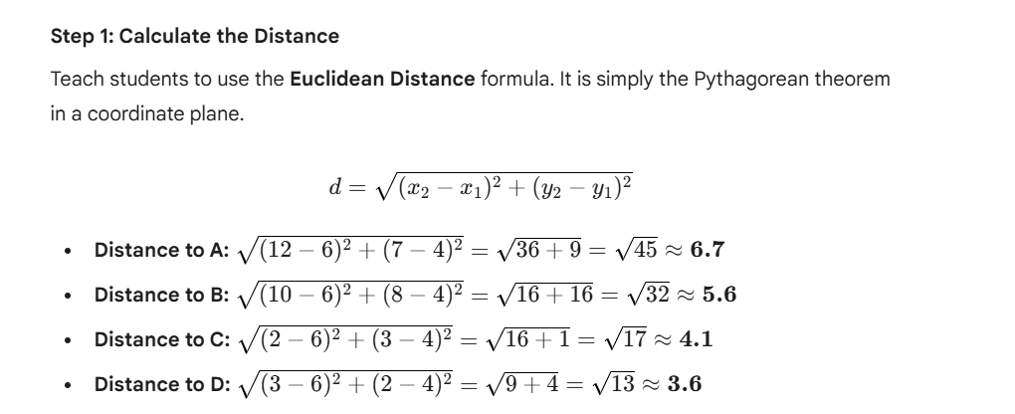

Slide 92


Slide 93


Slide 94


Slide 95
The Scenario: Predicting Loan Approval
A bank uses KNN to decide if a customer is "Low Risk" or "High Risk" based on:
Age
Income (scaled in $10k units)
Credit Score (1–10)

Slide 96

ID | Age | Income ($10k) | Credit Score | Label
A | 25 | 4 | 3 | High Risk
B | 35 | 10 | 9 | Low Risk
C | 45 | 12 | 8 | Low Risk
D | 20 | 5 | 2 | High Risk
E | 55 | 11 | 7 | Low Risk

Slide 97


Slide 98


Slide 99


Slide 100


Slide 101

BASICS OF PREDICTION

Slide 102


Slide 103


Slide 104

BASICS OF PREDICTION
Prediction Methods
Common prediction methods:
Linear Regression
Multiple Regression
Example:
$Y=a+bX$
Used for:
Sales forecasting
Price prediction

Slide 105
MODEL EVALUATION METRICS
What is a Confusion Matrix?
A Confusion Matrix is a table used to describe the performance of a classification model. It shows exactly where the model is "confused"
The 4 Key Terms:
True Positive (TP):.
True Negative (TN): Predicted FAIL, actually FAIL
False Positive (FP): Predicted PASS, actually FAIL.
False Negative (FN): Predicted FAIL, actually PASS.
Predicted PASS, actually PASS, Correct prediction

Slide 106
MODEL EVALUATION METRICS
Confusion Matrix
 | Predicted Yes | Predicted No
Actual Yes | TP | FN
Actual No | FP | TN
Where:
TP = True Positive
TN = True Negative
FP = False Positive
FN = False Negative

Slide 107
A teacher developed a simple model to predict whether students will PASS or FAIL in an examination. The model was tested on 50 students, and the following observations were recorded:
Out of 30 students who actually passed,
  25 were predicted as PASS
  5 were predicted as FAIL
Out of 20 students who actually failed,
  8 were predicted as PASS
  12 were predicted as FAIL
TP=25
TN=12
FP=8
FN=5

Slide 108
A test is conducted on 100 people.
40 people actually have the disease
60 people are healthy
Predictions:
Out of 40 sick → 32 predicted sick, 8 predicted healthy
Out of 60 healthy → 10 predicted sick, 50 predicted healthy
FN = 8
FP = 10
TN = 50
TP = 32

Slide 109

Accuracy
Definition:
Correct predictions out of total.
$Accuracy=\frac{TP+TN}{Total}$

Slide 110

Precision
Definition:Precision focuses only on positive predictions
Out of predicted positive, how many are correct?
$Precision=\frac{TP}{TP+FP}$

Slide 111

Recall
Definition:
Recall measures how well we find actual positives.
Out of actual positive, how many detected?
$Recall=\frac{TP}{TP+FN}$
Precision
Out of all students predicted PASS, how many actually passed?
Recall
Out of all students who actually passed, how many did we correctly identify?

Slide 112

F1 Score A single score that combines both correctness (precision) and completeness (recall)
$F1=\frac{2×Precision×Recall}{Precision+Recall}$
Used when:
Precision & Recall both important.

Slide 113
Given Confusion Matrix
Suppose:
TP = 40
TN = 50
FP = 10
FN = 20
Total = 120

Slide 114

Calculate Accuracy
$Accuracy=\frac{40+50}{120}$
$Accuracy=\frac{90}{120}=0.75$
Accuracy = 75%

Slide 115

Calculate Precision
$Precision=\frac{40}{40+10}$
$Precision=\frac{40}{50}=0.8$
Precision = 80%
Calculate Recall
$Recall=\frac{40}{40+20}$
$Recall=\frac{40}{60}=0.67$
Recall = 67%

Slide 116
Interpretation
Model correctly predicts 75% cases.
When model predicts positive → 80% correct.
It detects 67% of actual positive cases.

Slide 117
Summary
Classification → Predict category
Prediction → Predict numeric value
Algorithms:
Decision Tree
Naïve Bayes
KNN
Evaluation Metrics:
Accuracy
Precision
Recall
F1 Score
Confusion matrix

Slide 118

Using KNN ,predict the class for new data entry with brightness=20 saturation=35

Slide 119


Slide 120


